Slide 1
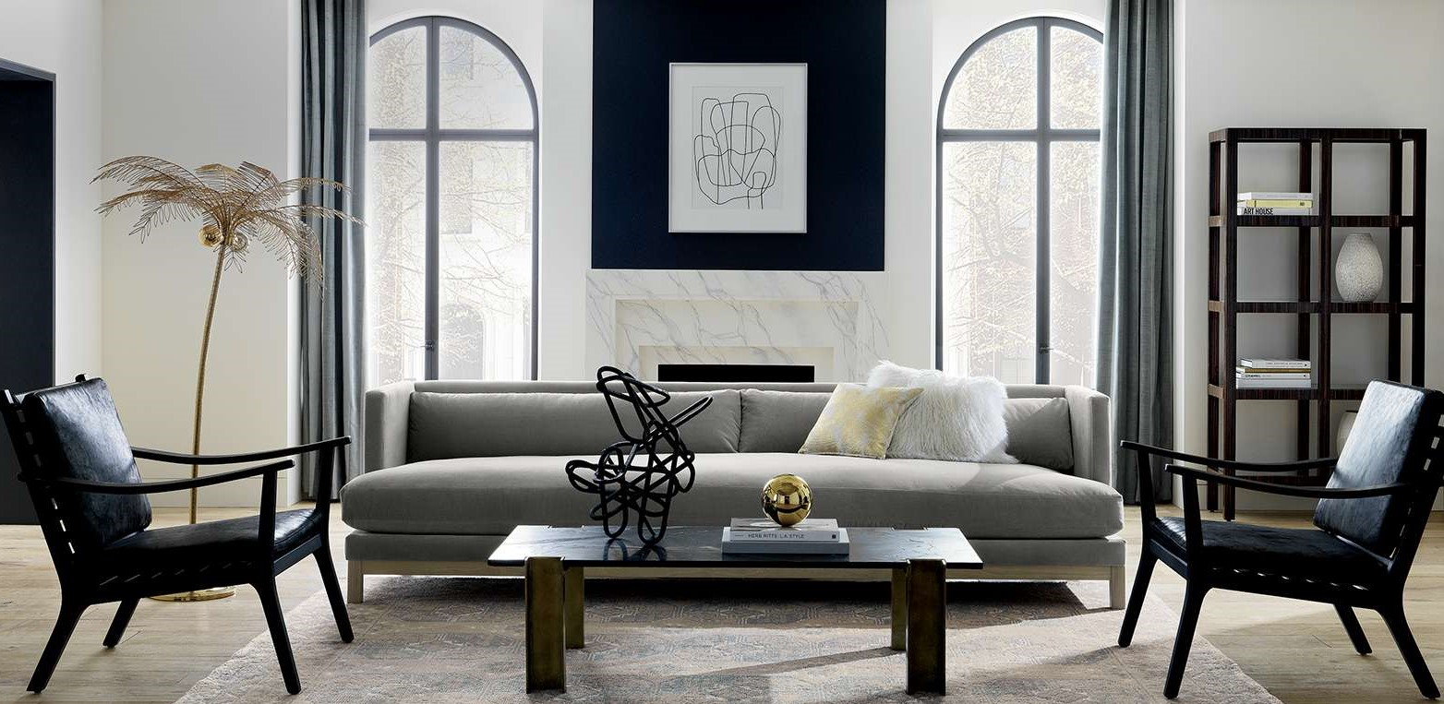
HOME DÉCOR HELPER
Anjali Sebastian

Slide 2
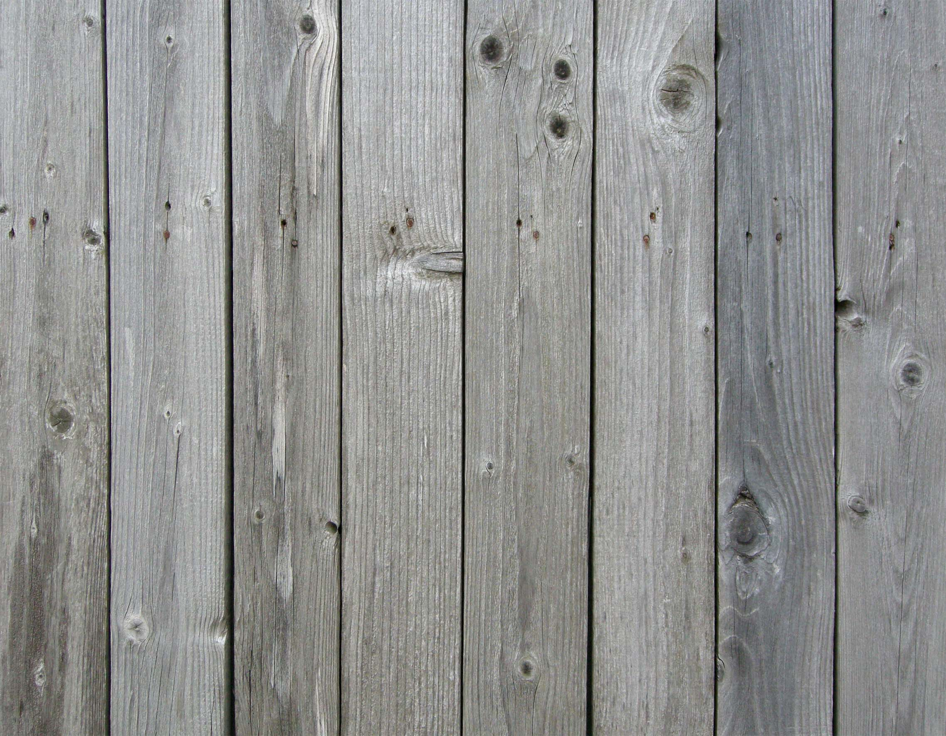
INTRODUCTION
I see furniture that I like, and I want to buy something that is similar…
but I don’t know WHERE?
or the price is too high?
Natural Language Processing and Deep Neural Networks to solve my problem

Slide 3
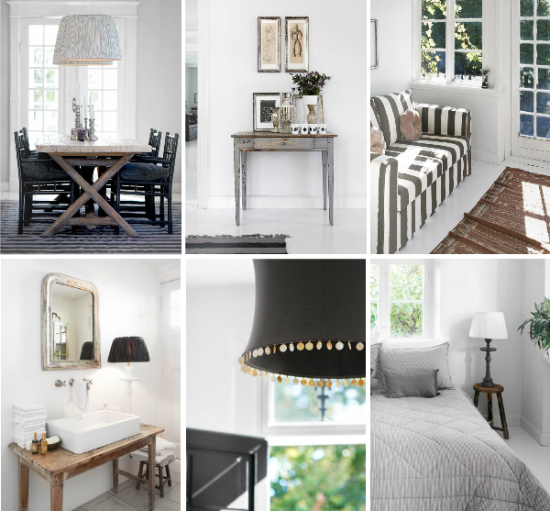
DATA
36,000 images and text description of products from overstock.com
Living Room Furniture

Slide 4








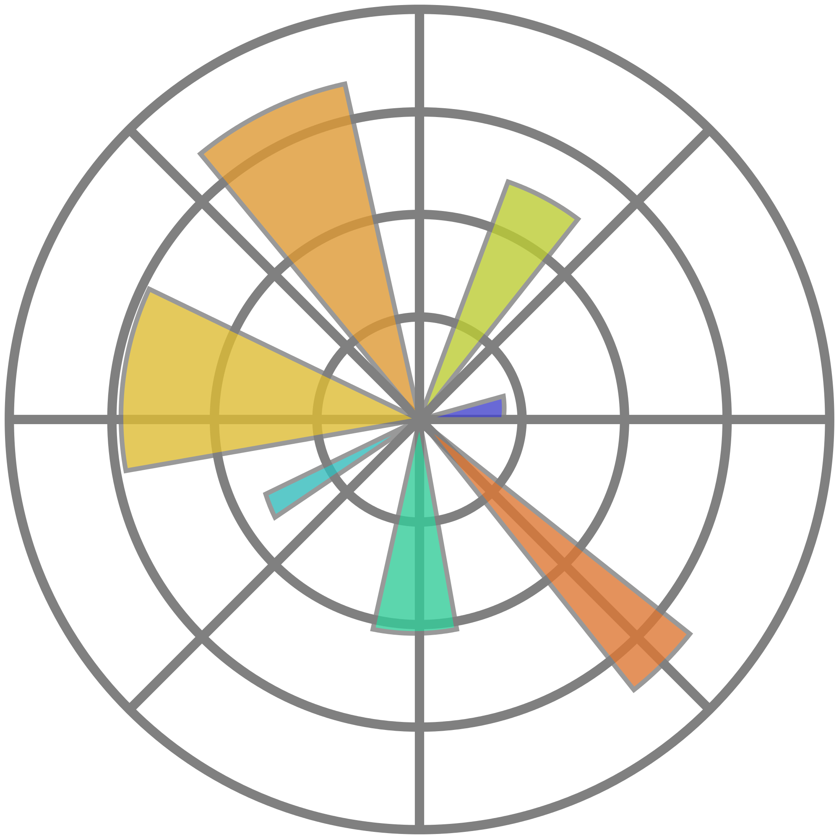





WORKFLOW DESIGN
Web Scraping
Data Cleaning
Image Pre-processing
Deep Learning
(CNN)
Product Images
Text Description
Image Classification
Join
Web Application
Text Analysis
NLP
Topic Model
(LDA)

Slide 5
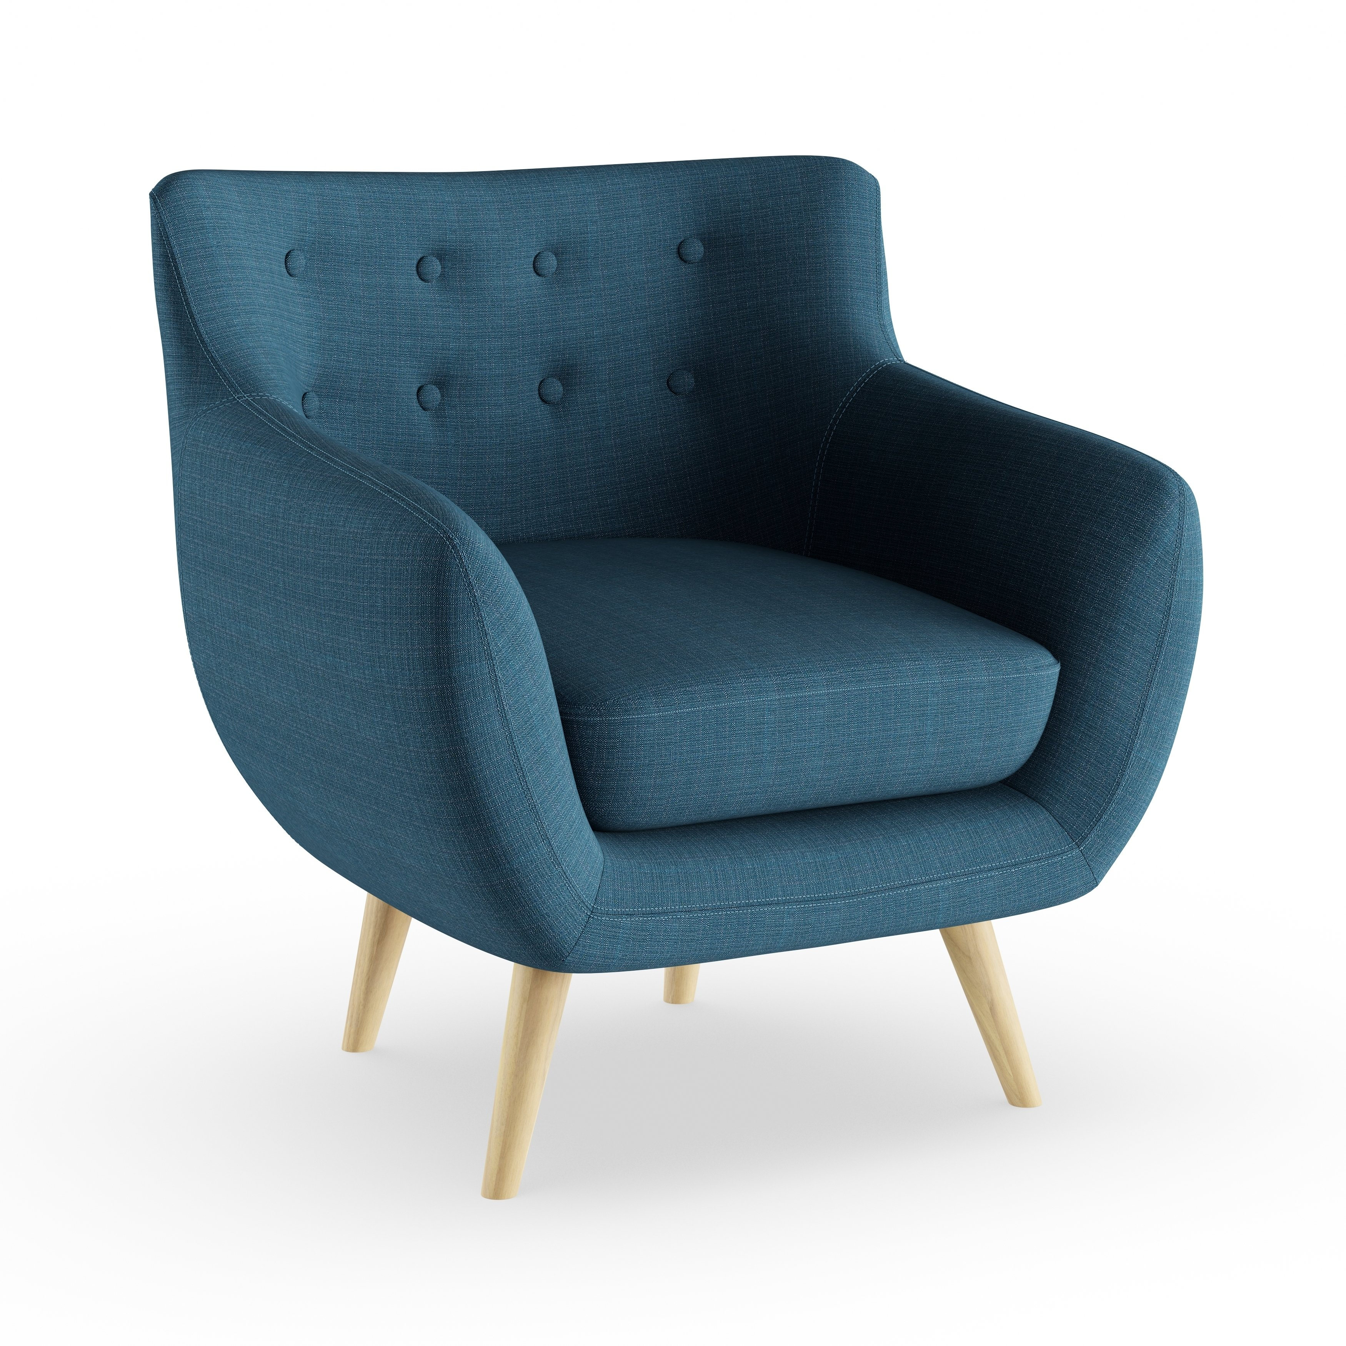
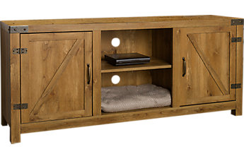
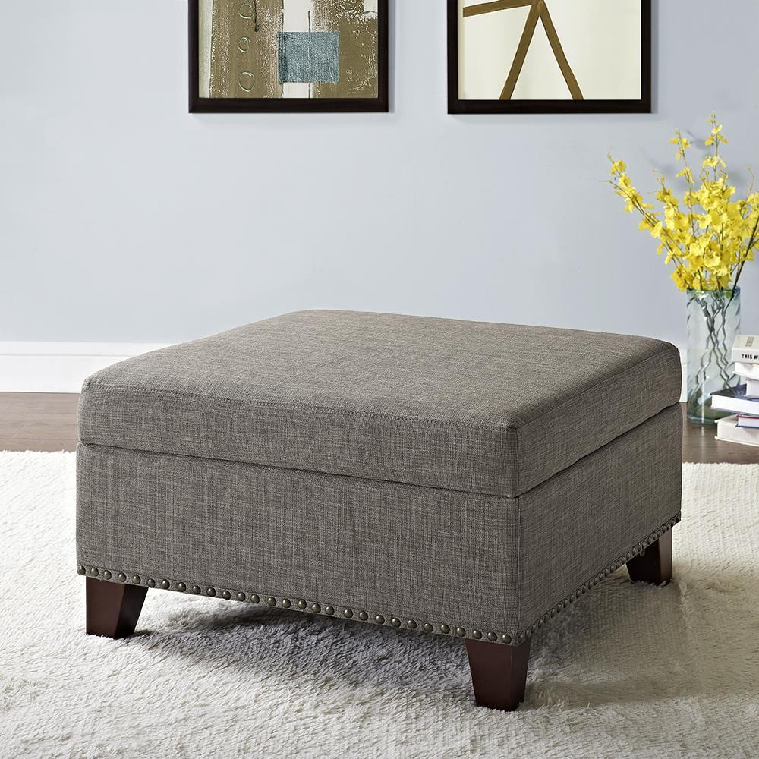
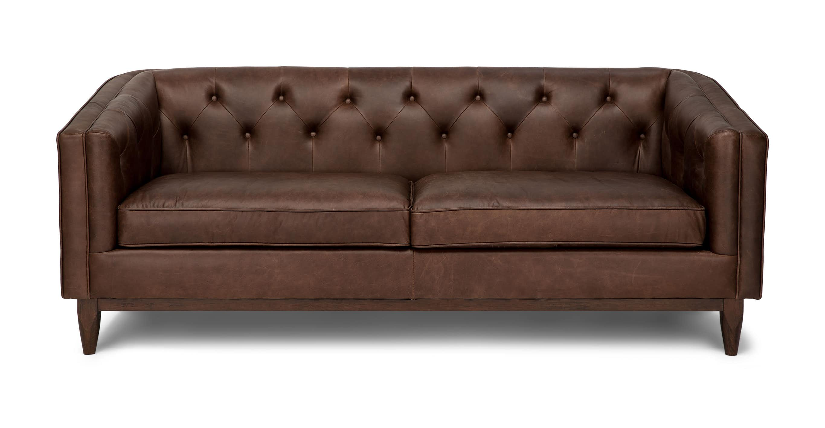
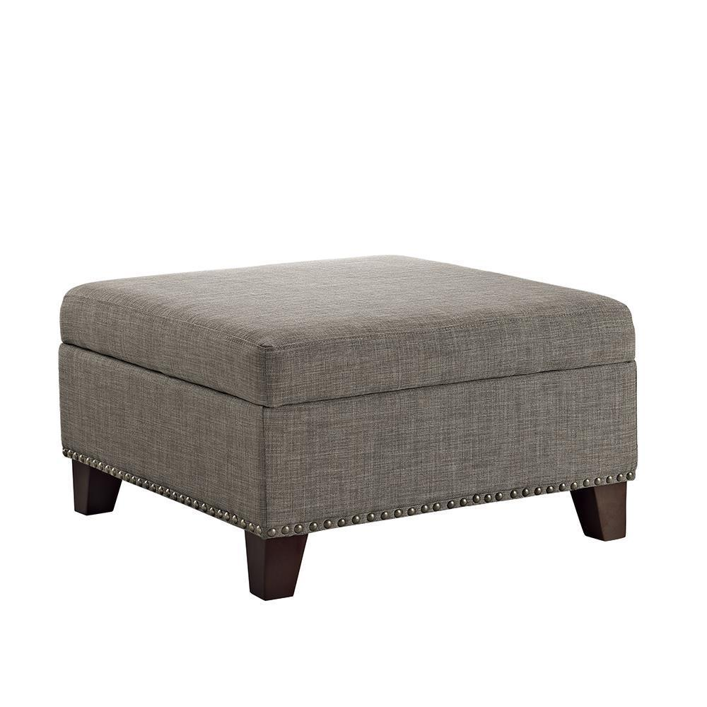
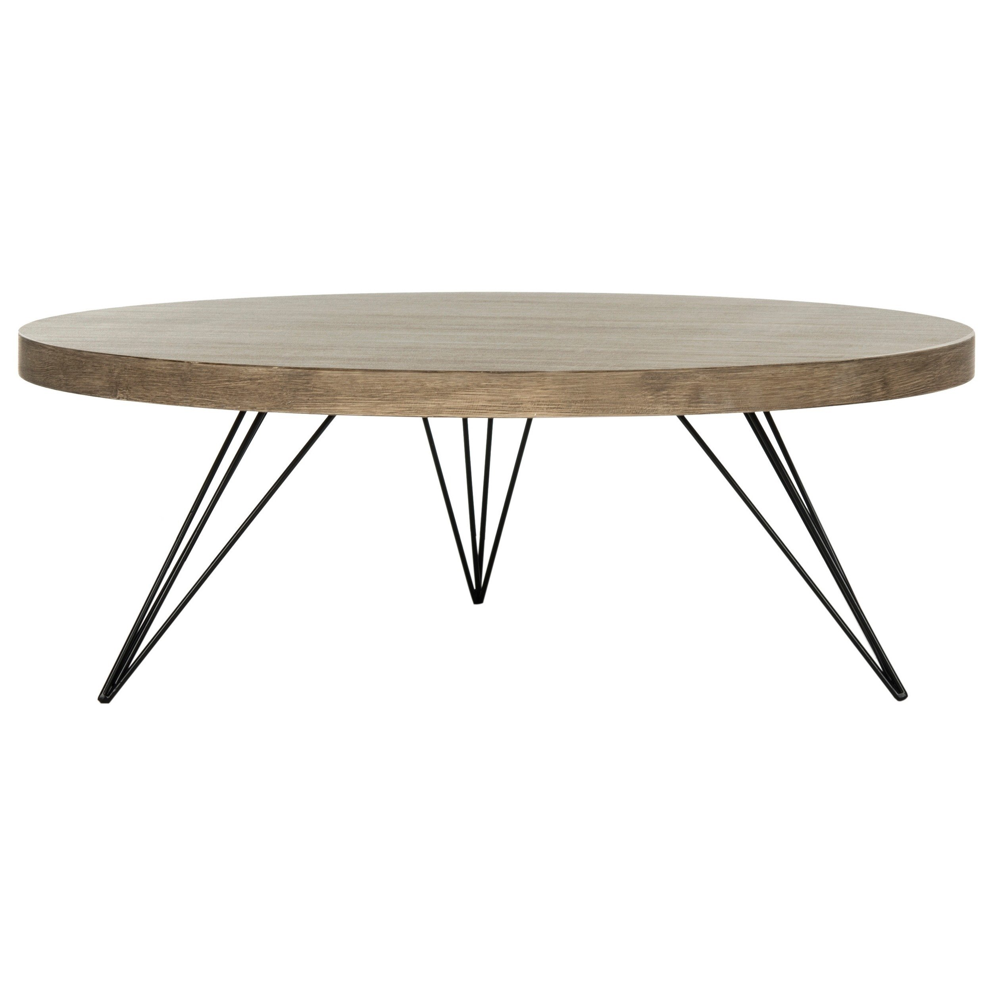
DEEP LEARNING MODEL
Armchair
TV Console
Maxpooling
Maxpooling
3 layers
Maxpooling
3 layers
Maxpooling
3 layers
Image
2 layers
2 layers
3 layers
Maxpooling
128 Neurons
64 Neurons
Dropout
Sofa
VGG 16 Pre-trained
Ottoman
Convolution Layer
Max-pooling
Fully Connected
Dropout Layer
91% Accuracy
Coffee Table
Image Features

Slide 6


WEB APPLICATION LOGIC
User Uploaded
Image
Deep Learning
Model
Deep Learning
Model
Similarity Measures
Image Catalogue
User entered description
NLP
Model
NLP
Model
Product Descriptions
Display Results

Slide 7

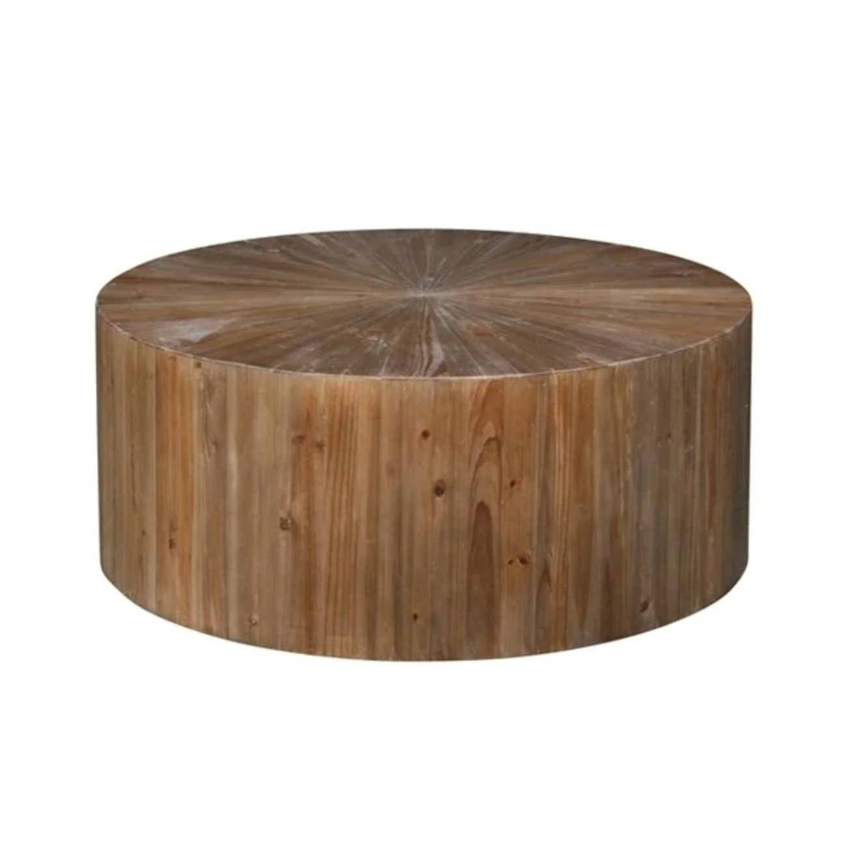
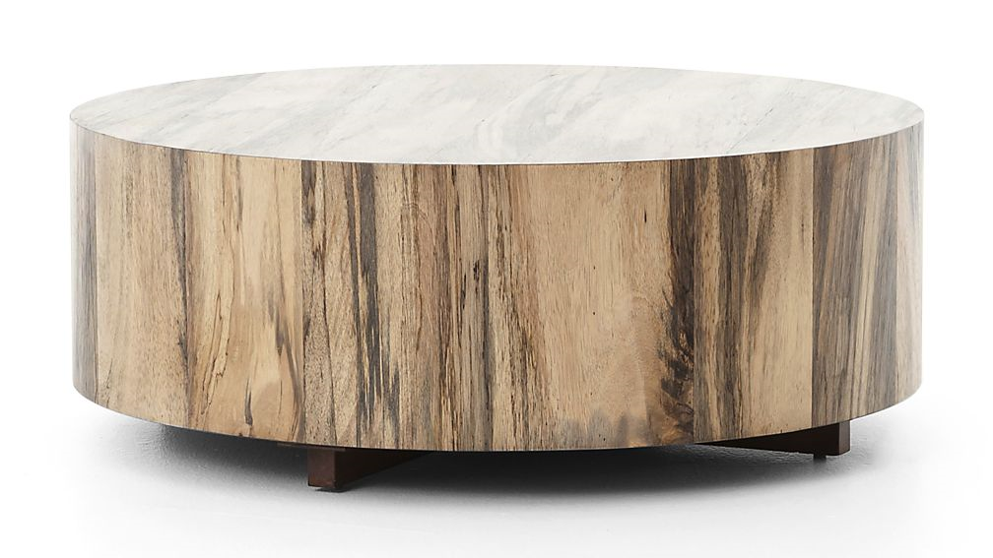
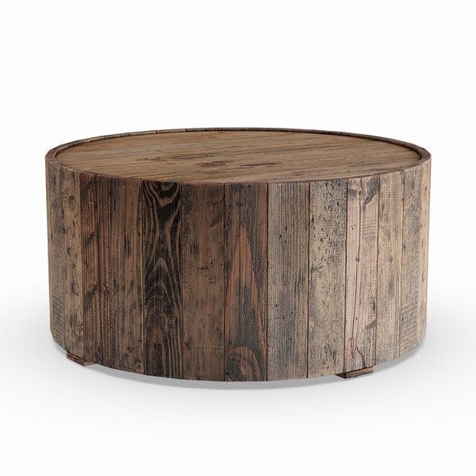
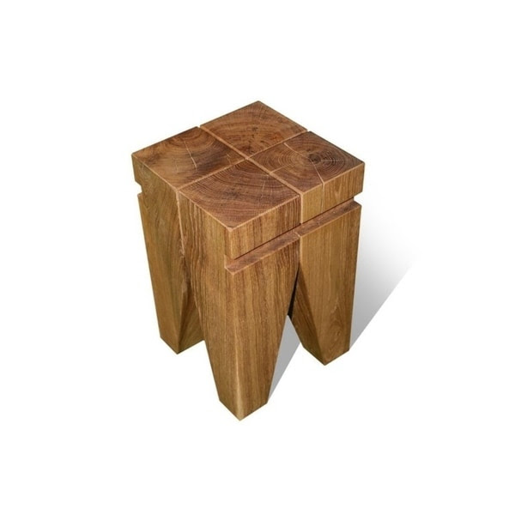
CHEAPER OPTIONS
Crate & Barrel
Hudson Spalted Primavera Round Wood Coffee Table
“Wood wooden distressed pine oak reclaimed coffee table natural”
Original Price
$1,565
Our Options
$300 – $1000

Slide 8
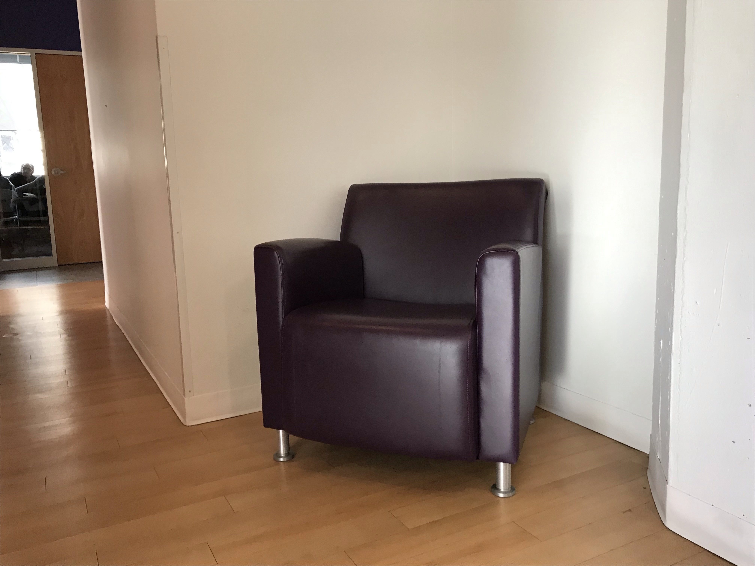
WEB APPLICATION VIDEO
Took photograph of armchair at Metis
Let’s see, what suggestions we get…

Slide 9
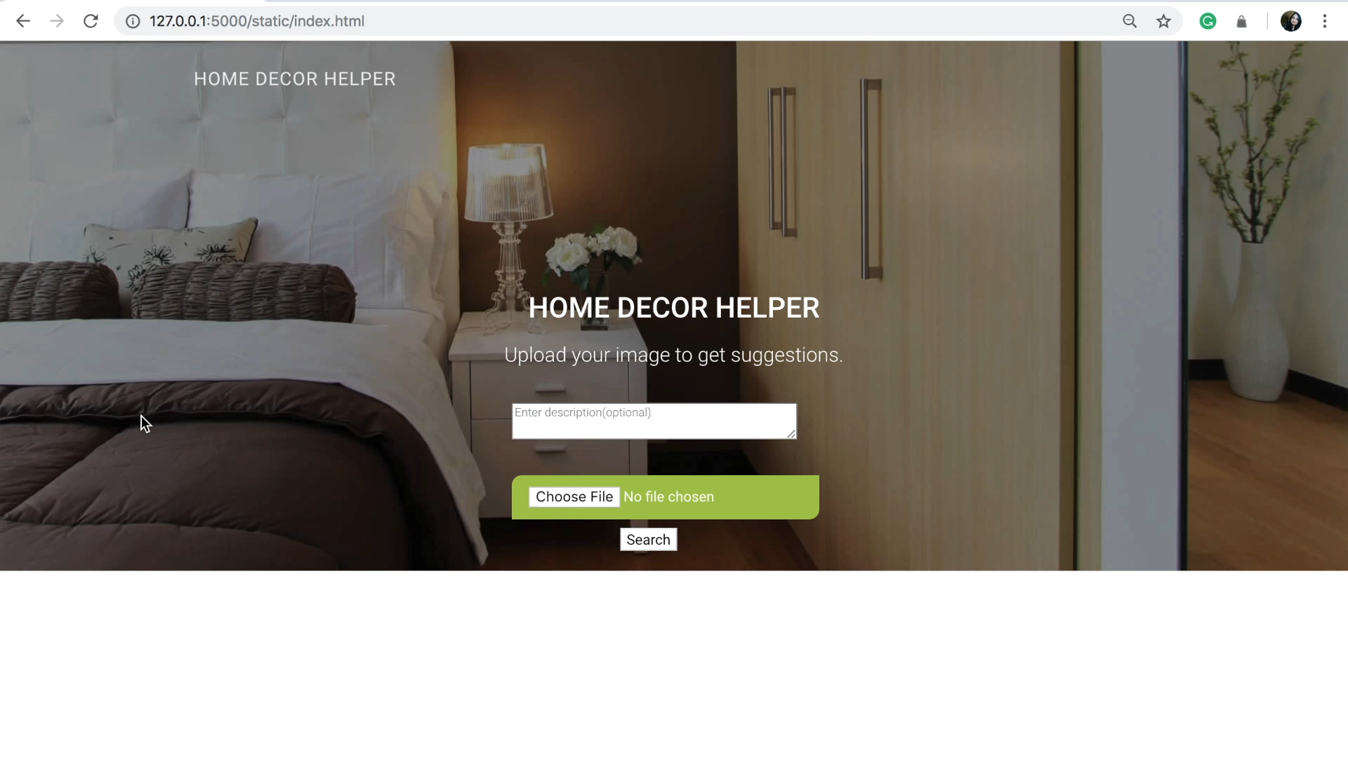

Slide 10
FUTURE WORK
Viewing angles, background and lighting conditions
More tolerant to bad photography
Learn from user images
Add more categories and products
Multi-level suggestions

Slide 11

anjumorris@gmail.com
/anjali-sebastian
/anjumorris
206-432-6019
medium.com/@anjumorris
THANK YOU

